Slide 1
Lecture 18: Variational Autoencoders

Slide 2
Outline
Motivation for Variational Autoencoders (VAE)
Mechanics of VAE
Separability of VAE
The math behind everything
Generative models

Slide 3
Outline
Motivation for Variational Autoencoders (VAE)
Mechanics of VAE
Separability of VAE
The math behind everything
Generative models

Slide 4
Generating Data (is exciting)
https://arxiv.org/pdf/1708.05509.pdf

Slide 5
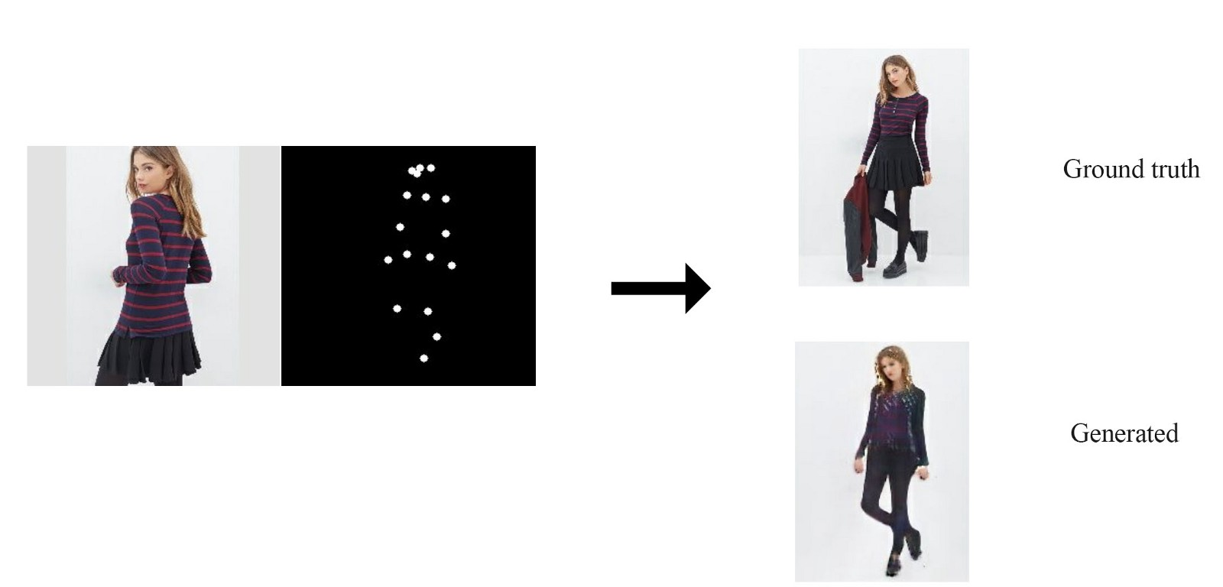
Generating Data (is exciting)

Slide 6
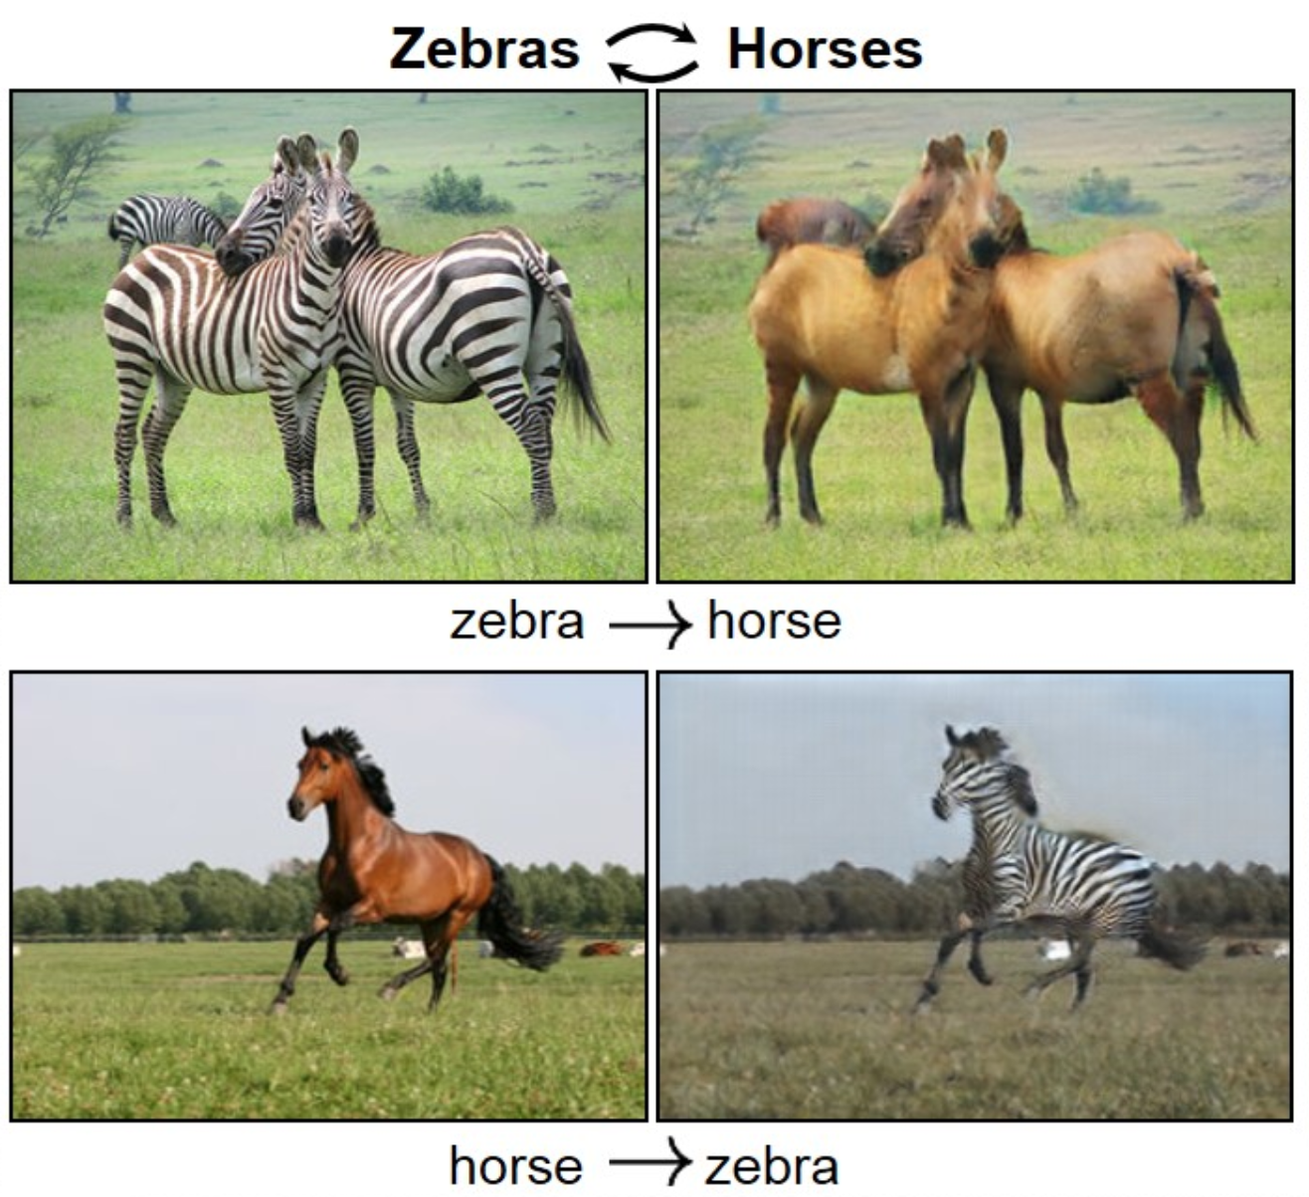
Generating Data (is exciting)

Slide 8
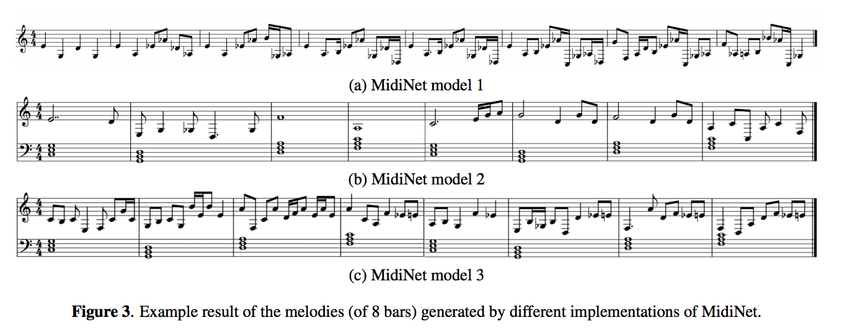

Slide 9
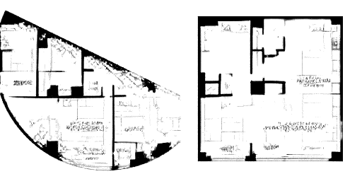
Another use of generating new data is to give us ideas and options. Suppose we’re planning a house. We can give the computer the space we have available, and its location. From this, the computer can can give us some ideas.

Slide 10
Big networks require big data, and getting high-quality, labeled data is difficult. If we’re generating that data our selves, we can make as much of it as we like.

Slide 11
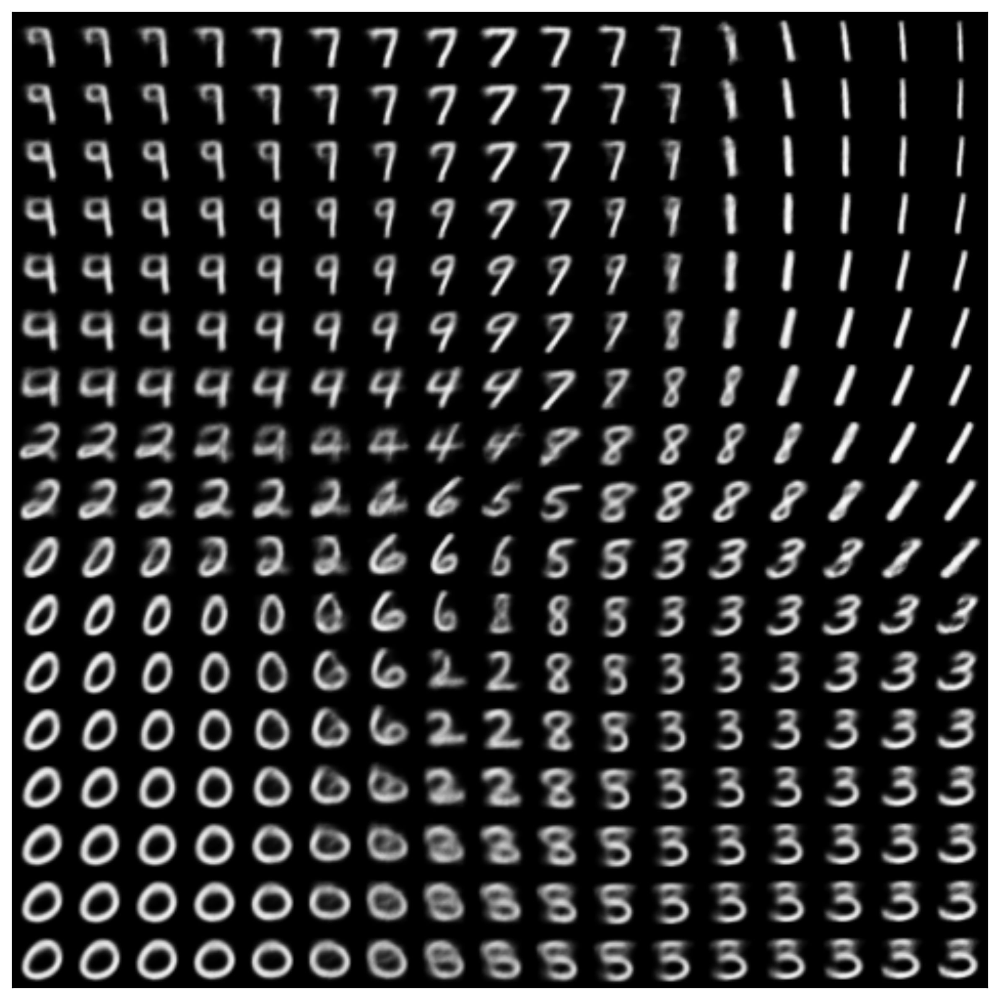
Generating Data
We saw how to generate new data with a AE in Lecture 12.

Slide 12
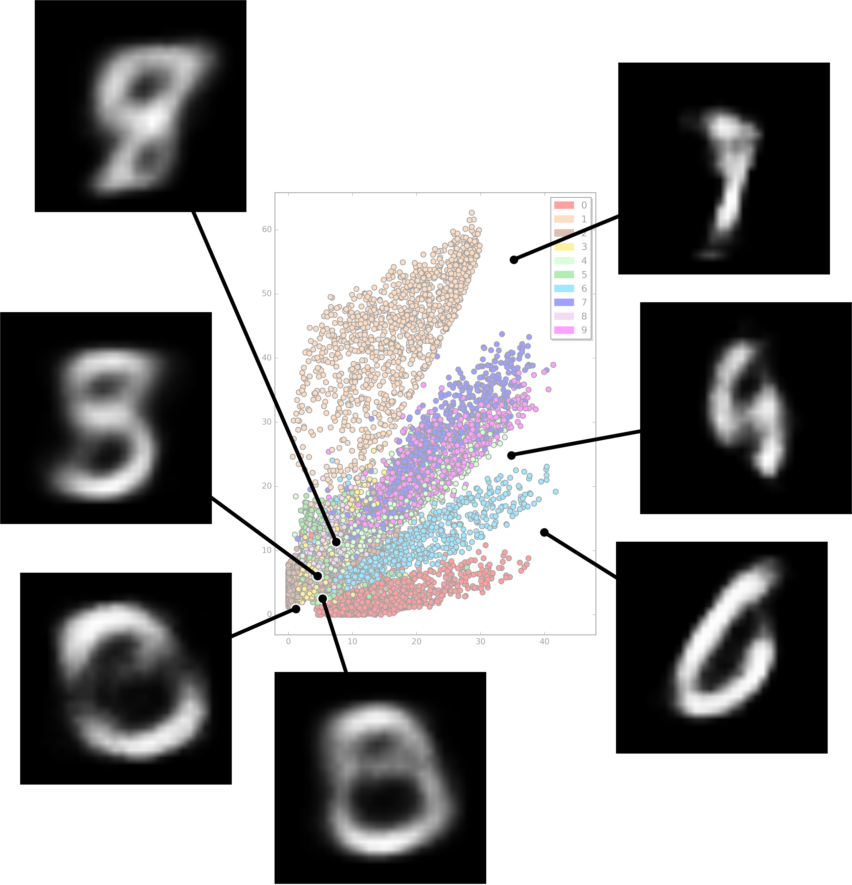
Problems with Autoencoders (from lecture 12)
Gaps in the latent space
Discrete latent space
Separability in the latent space

Slide 13
Outline
Motivation for Variational Autoencoders (VAE)
Mechanics of VAE
Seperability of VAE
The math behind everything
Generative models

Slide 14
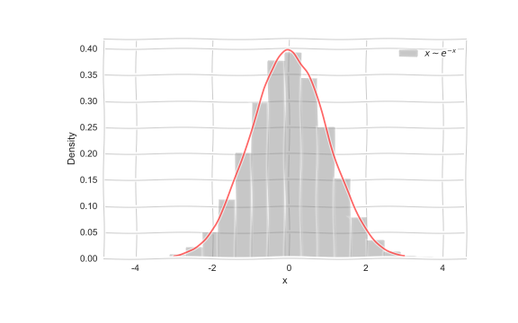
Generative models
Imagine we want to generate data from a distribution,
e.g.

Slide 15
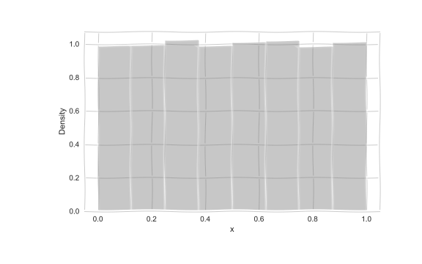
Generative models
But how do we generate such samples?

Slide 16
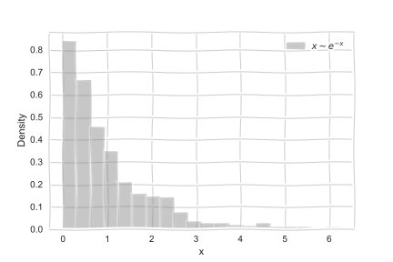
Generative models
But how do we generate such samples?

Slide 17
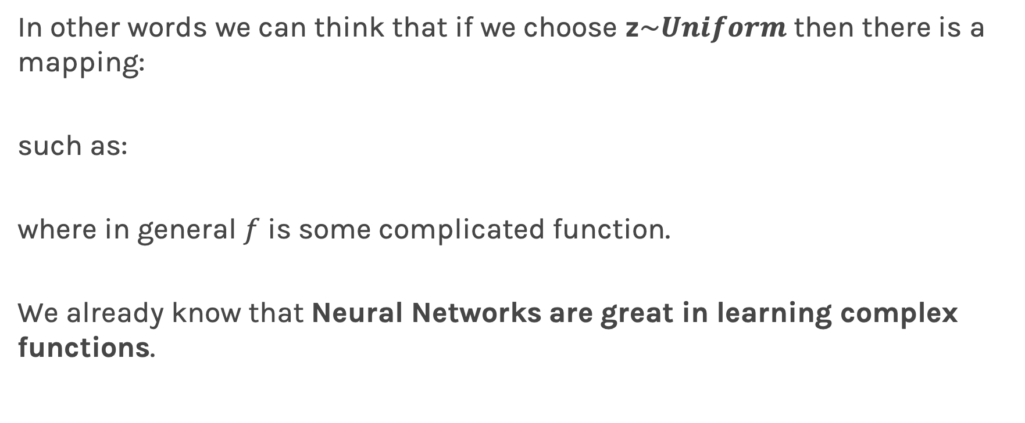
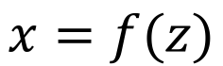
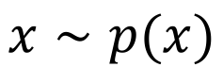
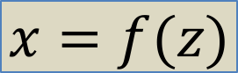
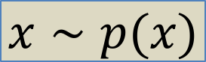
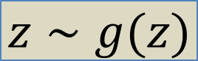
Generative models
In other words we can think that if we choose z$\sim Uniform$ then there is a mapping:
such as:
where in general $f$ is some complicated function.
We already know that Neural Networks are great in learning complex functions.
$$x=f(z)$$
$$x∼p(x)$$
$$z∼g(z)$$
$$x=f(z)$$
$$x∼p(x)$$

Slide 18
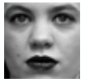
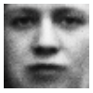
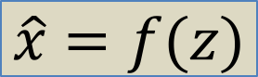
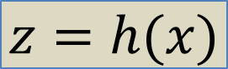
Traditional Autoencoders
In traditional autoencoders, we can thing of encoder and decoders as some function mapping.
Encoder
z
Decoder
$$z=h(x)$$
$$\hat{x}=f(z)$$

Slide 19
Variational Autoencoders
To go to variational autoencoders, we need to first add some stochasticity and think of it as a probabilistic modeling.
Encoder
z
Decoder

Slide 20


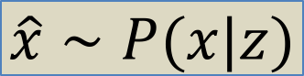
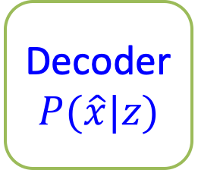
Variational Autoencoders
Sample from g(z)
e.g. Standard Gaussian
z
Decoder
$$P(\hat{x}|z)$$
$$z∼g(z)$$
$$\hat{x}=f(z)$$
$$\hat{x}∼P(x|z)$$

Slide 21
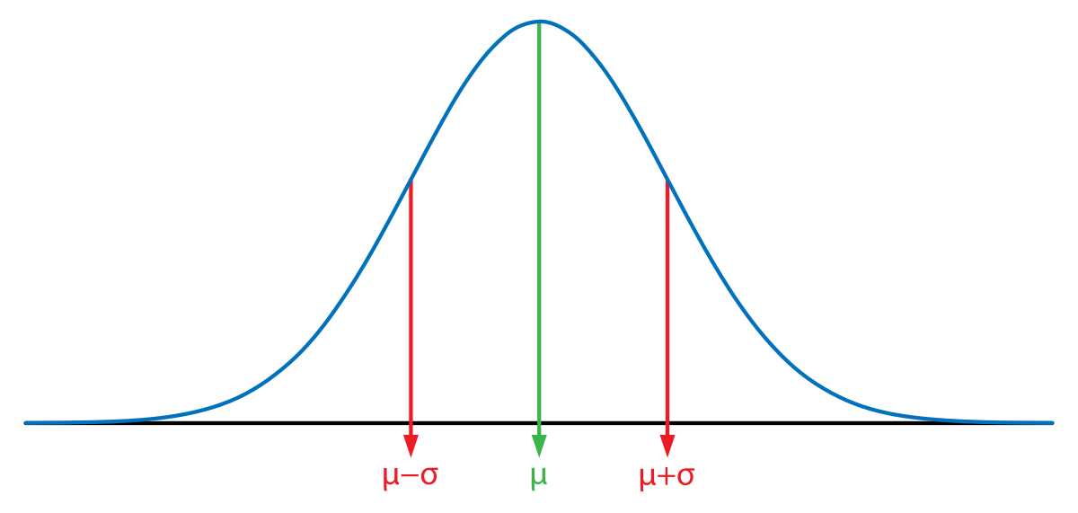

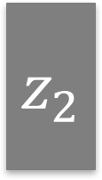
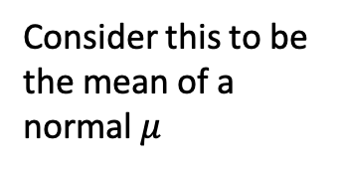
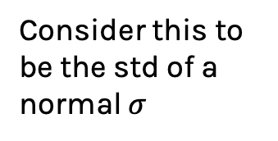
Variational Autoencoders
Traditional AE
Encoder
z
$$z_{1}$$
Consider this to be the mean of a normal $μ$
Encoder
Decoder
$$z_{2}$$
Consider this to be the std of a normal $σ$
Randomly chosen value
Latent value, z

Slide 22
Variational Autoencoders

Slide 23
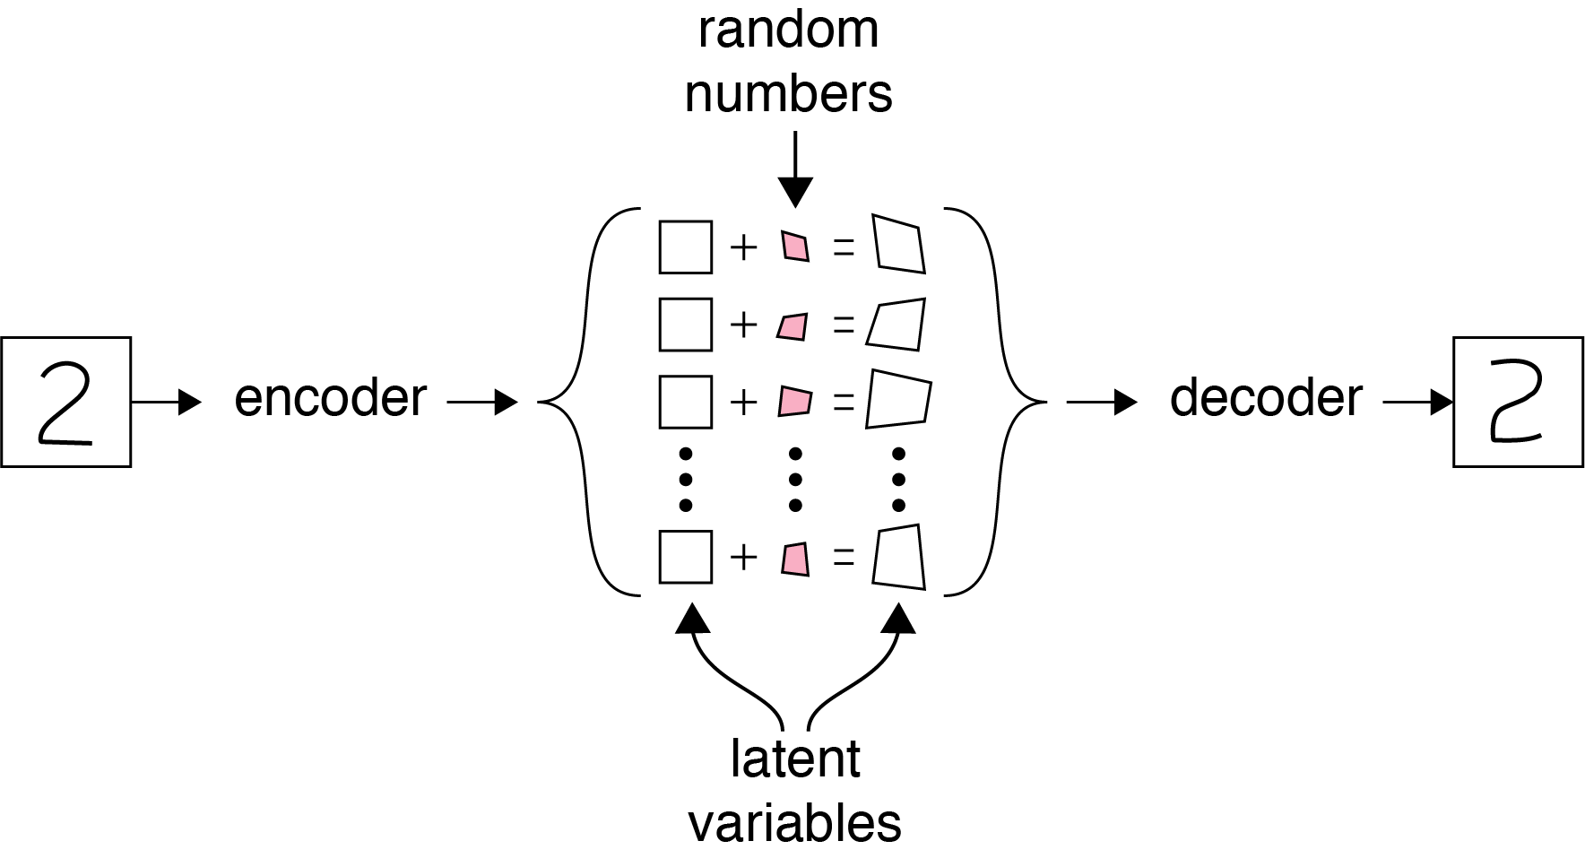
Variational Autoencoders

Slide 24
Variational Autoencoders
512 neurons
ReLU
256 neurons
ReLU
20 neurons
ReLU
256 neurons
ReLU
512 neurons
ReLU
784 neurons
ReLU
Centers
512 neurons
ReLU
256 neurons
ReLU
20 neurons
ReLU
256 neurons
ReLU
512 neurons
ReLU
784 neurons
ReLU
Centers
Spreads

Slide 25
Outline
Motivation for Variational Autoencoders (VAE)
Mechanics of VAE
Separability of VAE
The math behind everything
Generative models

Slide 26
Separability in Variational Autoencoders
Separability is not only between classes but we also want similar items in the same class to be near each other.
This is similar to word encoding we have talked in the previous lecture.
For example, there are different ways of writing “2”, we want similar styles to end up near each other.
Let’s examine VAE, there is something magic happening once we add stochasticity in the latent space.

Slide 27
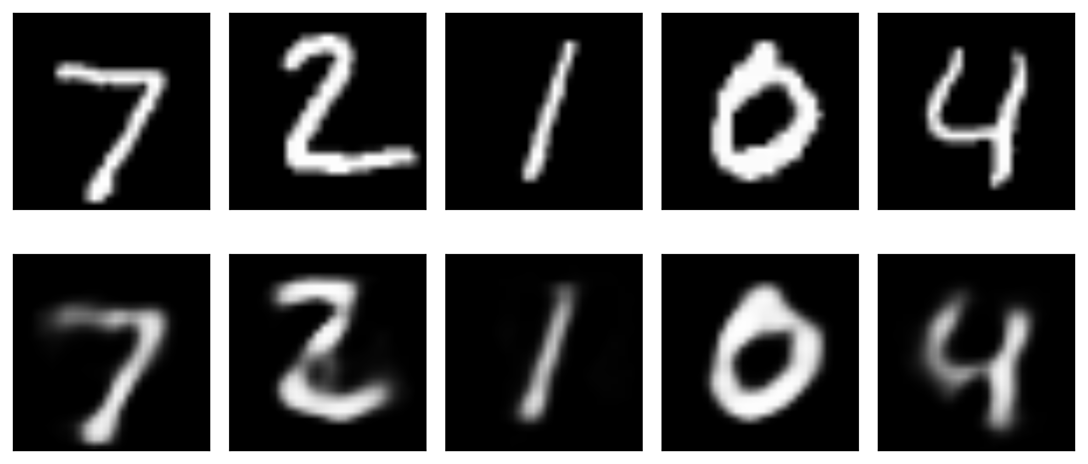
Separability in Variational Autoencoders
Latent Space
ENCODER
DECODER

Slide 28
Separability in Variational Autoencoders
Latent Space
ENCODER
DECODER

Slide 29
Blending Latent Variables
Latent Space
ENCODER
DECODER

Slide 30

Separability in Variational Autoencoders
Latent Space
ENCODER
DECODER

Slide 31
Separability in Variational Autoencoders
Latent Space
ENCODER
DECODER

Slide 32
Separability in Variational Autoencoders
Latent Space
ENCODER
DECODER

Slide 33
Separability in Variational Autoencoders
Train with 1st sample again
Latent Space
ENCODER
DECODER

Slide 34

Separability in Variational Autoencoders
Train with 1st sample again
Latent Space
ENCODER
DECODER
Latent space starts to
re-organize

Slide 35
Separability in Variational Autoencoders
And again…
Latent Space
ENCODER
DECODER
3 is pushed away

Slide 36
Separability in Variational Autoencoders
Many times…
Latent Space
ENCODER
DECODER

Slide 37
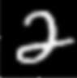
Separability in Variational Autoencoders
Now lets test again
Latent Space
ENCODER
DECODER

Slide 38

Separability in Variational Autoencoders
Training on 3’s again
Latent Space
ENCODER
DECODER

Slide 39
Separability in Variational Autoencoders
Many times…
Latent Space
ENCODER
DECODER

Slide 41
Outline
Motivation for Variational Autoencoders (VAE)
Mechanics of VAE
Seperability of VAE
The math behind everything
Generative models

Slide 42
VAE Likelihood
Neural network
Difficult to approximate in high dim through sampling
For most z values p(x|z) close to 0

Slide 43
VAE Likelihood
Another neural net
Proposal distribution:
Likely to produce values of x for which p(x|z) is non-zero

Slide 44
VAE Architecture
q_{ϕ}(z|x)
Encoder
z
Decoder
p_{θ}(x|z)
Notes:
http://kvfrans.com/variational-autoencoders-explained/
https://arxiv.org/pdf/1606.05908.pdf

Slide 45
VAE Loss
Proposal distribution should resemble a Gaussian
Reconstruction Loss

Slide 46
VAE Loss
Proposal distribution should resemble a Gaussian
Reconstruction Loss

Slide 47
VAE Loss
Proposal distribution should resemble a Gaussian
Reconstruction Loss
Variational upper bound on loss we care about!

Slide 48
Training VAE
Apply stochastic gradient descent
Sampling step not differentiable
Use a re-parameterization trick
Move sampling to input layer, so that the sampling step is independent of the model

Slide 49

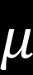
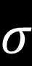
Reparametrization Trick
Encoder
$$μ$$
Decoder
z
$$σ$$

Slide 50
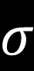
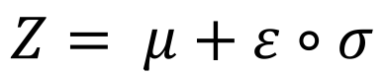
Reparametrization Trick
Encoder
$$μ$$
Decoder
z
$$σ$$
$$Z= μ+ε∘σ$$

Slide 51
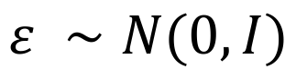
Reparametrization Trick
Encoder
$$μ$$
Decoder
z
$$σ$$
$$Z= μ+ε∘σ$$
$$ε ∼N(0,I)$$

Slide 52
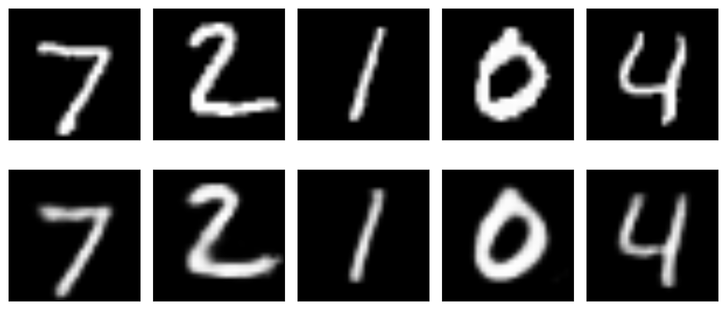
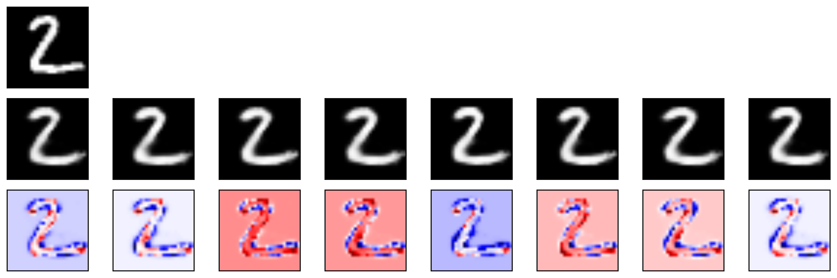
Training VAE

Slide 53
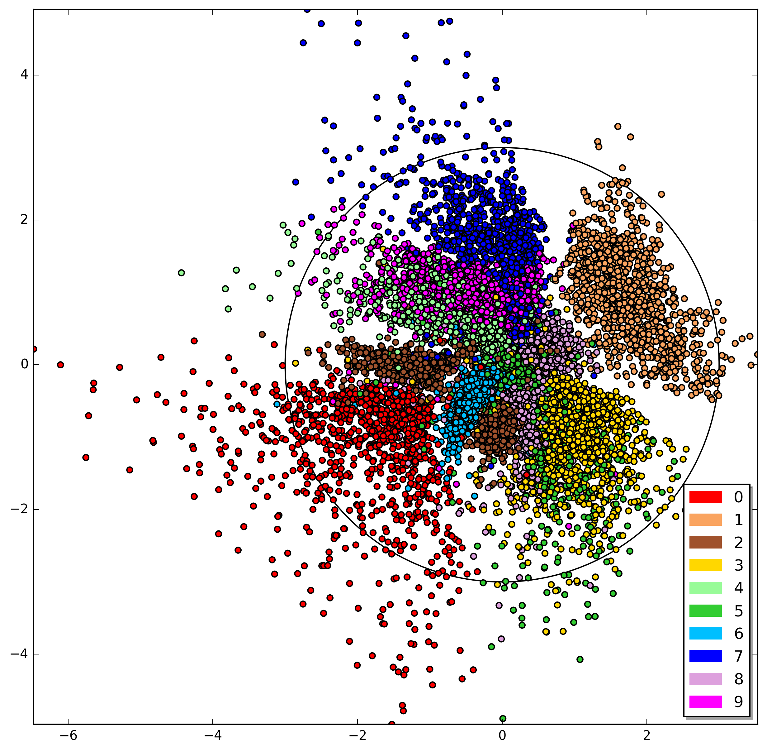
Parameter space VAE

Slide 54
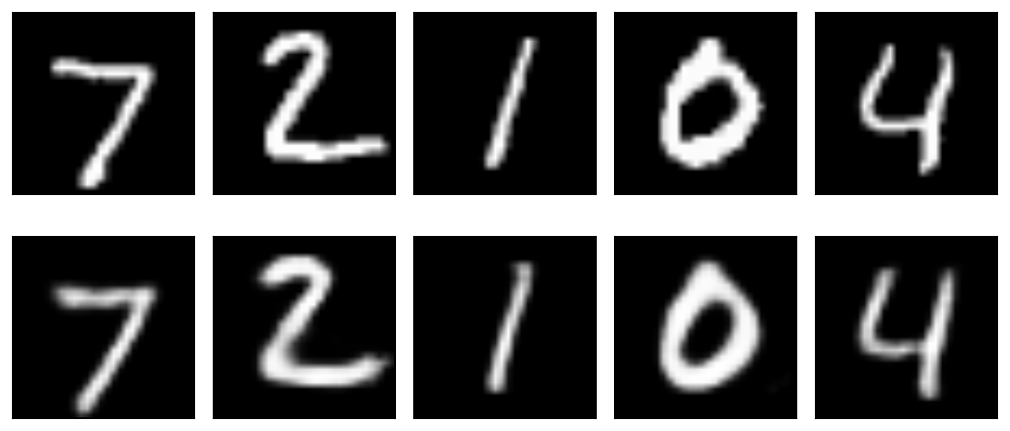
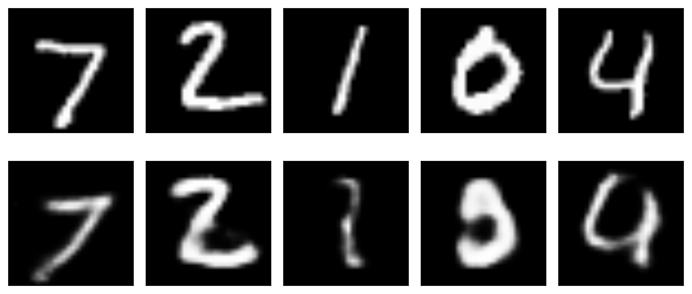
Training VAE
10% error
30% error

Slide 55
Parameter space VAE

